Slide 1
CS 242 - Data Structures
Algorithm Analysis

Slide 2
Why need algorithm analysis ?
Writing a working program is not good enough
The program may be inefficient!
If the program is run on a large data set, then the running time becomes an issue
Notes:
An algorithm is a clearly specified set of simple instructions to be followed to solve a problem. Once an algorithm is given for a problem and decided (somehow) to be correct, an important step is to determine how much in the way of resources, such as time or space, the algorithm will require.
An algorithm that solves a problem but requires a year is hardly of any use. Likewise, an algorithm that requires hundreds of gigabytes of main memory is not (currently) useful on most machines.

Slide 3
Algorithm Efficiency
The content of the input affects the running time
The input size (number of items in the input) is the main consideration
E.g. sorting problem: the number of items to be sorted
E.g. multiply two matrices together: the total number of elements in the two matrices
Machine model assumed Instructions are executed one after another, with no concurrent operations
Not parallel computers

Slide 4
Experimental Analysis
Two algorithms for composing a string of repeated characters
/** Uses repeated concatenation to compose a String with n copies of character c. */
public static String repeat1(char c, int n) {
String answer = "";
for (int j=0; j < n; j++)
answer += c;
return answer;
}
/** Uses StringBuilder to compose a String with n copies of character c. */
public static String repeat2(char c, int n) {
StringBuilder sb = new StringBuilder( );
for (int j=0; j < n; j++)
sb.append(c);
return sb.toString( );
}

Slide 5
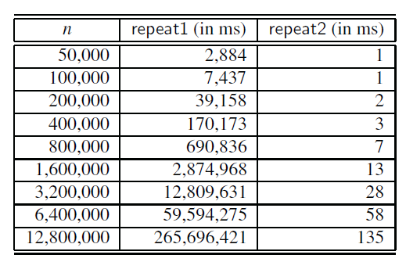
Experimental Analysis
Results of timing
3 days !
< 1 sec
Notes:
As an experiment, we used System.currentTimeMillis( ), in the style of Code Fragment 4.1, to measure the efficiency of both repeat1 and repeat2 for very large strings. We executed trials to compose strings of increasing lengths to explore the relationship between the running time and the string length. The results of our experiments are shown in the Table
The most striking outcome of these experiments is how much faster the repeat2 algorithm is relative to repeat1. While repeat1 is already taking more than 3 days to compose a string of 12.8 million characters, repeat2 is able to do the same in a fraction of a second.

Slide 6
Algorithm Efficiency
Predicting the resources that the algorithm requires such as
Memory
Communication bandwidth
Computational time (usually most important)
Factors affecting the running time
Computer, compiler, algorithm used, input to the algorithm

Slide 7
Moving Beyond Experimental Analysis
Our goal is to develop an approach to analyzing the efficiency of algorithms that:
Allows us to evaluate the relative efficiency of any two algorithms in a way that is independent of the hardware and software environment.
Is performed by studying a high-level description of the algorithm without need for implementation.
Takes into account all possible inputs.

Slide 8
Time complexity & Primitive Operation
Time complexity is the execution time it takes for your algorithm to solve a problem.
Primitive Operations are basic computations performed by an algorithm such as:
Evaluating an expression
Following an object reference
Performing an arithmetic operation (for example, adding two numbers)
Assigning a value to a variable
Indexing into an array
Calling a method
Returning from a method
Notes:
To analyze the running time of an algorithm without performing experiments, we perform an analysis directly on a high-level description of the algorithm (either in
the form of an actual code fragment, or language-independent pseudocode). We define a set of primitive operations such as the following:

Slide 9
Counting Primitive Operations
f(n)= 6n + 4
# operations
public static int sum( int n )
{
int partialSum; The declarations count for no time
partialSum = 0; 1
for( int i = 1 ; i <= n ; i++ ) 2N + 2
partialSum += i * i * i; 4N
return partialSum; 1
}
Total 6n + 4
Notes:
1 to initialize, N+1 for all the tests, and N for all the increments, which is 2N + 2.
(two multiplications, one addition, and one assignment) and is executed N times.

Slide 10
Big-O Notation
We are not interested in knowing the exact number of operations the algorithm performs. mainly interested in knowing how the number of operations grows with increased input size.
Why?
Given large enough input, the algorithm with faster growth will execute more operations and takes long time
The simplification of efficiency is known as big-O analysis.
We don’t need to determine the complete measure of efficiency, only the factor that determines the magnitude. This factor is the big-O, and expressed as O(n) – that is, on the order of n.
Notes:
since we are giving the answer in terms of Big-Oh, there are lots of shortcuts that can be taken without affecting the final answer. For instance, line 3 is obviously an O(1) statement (per execution), so it is silly to count precisely whether it is two, three, or four units; it does not matter. Line 1 is obviously insignificant compared with the for loop, so it is silly to waste time here. This leads to several general rules.
We fouce on iteration and recursive.

Slide 11
Big-O Notation
The big O notation can be derived from f(n) using the following steps:
Ignore the lower order terms and the coefficients of the highest-order term
Keep the largest term in the function and discard the others.
No need to specify the base of logarithm
Nested loop
Iterations = inner loop iterations x outer loop iterations
Consecutive program fragments (Larger O( f(n) ) )
If statement (worst-case scenario)

Slide 12
Algorithm Efficiency Categories
Efficiency | Big-O | Iterations | Estimated Time
Logarithmic | O(log₂n) | 14 | Microseconds
Linear | O(n) | 10,000 | 0.1 seconds
Linear logarithmic | O(n(log₂n)) | 140,000 | 2 seconds
Quadratic | O(n²) | 10,000 | 15-20 minutes
Polynomial | O(n^{k}) | 10,000 | Hours
Exponential | O(c^{n}) | 2 ^{10,000} | Intractable
Factorial | O(n!) | 10,000! | Intractable
*assume instruction speed of 1 microsecond and 10 instructions in loop

Slide 13
Example 1
Linear loop
What if we change the incremental condition? Ex: i=i+2
iteration | Value of i
1 | 1
2 | 2
3 | 3
… | …
n | n
i = 1
loop ( i <= n )
application code
i=i+1
end loop
n
O(n)

Slide 14
Example 2
iteration | Value of i
1 | 1
2 | 2
3 | 4
4 | 8
5 | 16
6 | 32
7 | 64
8 | 128
9 | 256
10 | 512
11 | 1024
Logarithmic loop
2 ^{iteration} < 1000
i = 1
loop ( i < n )
application code
i = i x 2
end loop
O(log₂ n)
Notes:
Let n=1000

Slide 15
Example 3
iteration | Value of i
1 | 1000
2 | 500
3 | 250
4 | 125
5 | 62
6 | 31
7 | 15
8 | 7
9 | 3
10 | 1
Exit | 0
Logarithmic loop
1000 /2 ^{iteration} >=1
i=n
loop ( i >= 1)
application code
i = i / 2
end loop
O(log₂ n)
Notes:
Let n=1000

Slide 16
Example 4
Linear logarithmic
i=1
loop ( i <= n )
j=1
loop ( j <=n )
application code
j= j x 2
end loop
i = i + 1
end loop
n
log₂ n
O(n [log₂ n])

Slide 17
Example 5
Nested loop
Quadratic
i = 1
loop ( i <= 10 )
j = 1
loop ( j <= 10 )
application code
j = j +1
end loop
i = i + 1
end loop
O(n²)
n
n

Slide 18
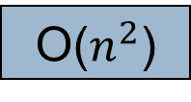
Example 6
Nested loop
Dependent Quadratic: inner loop iteration depend upon the outer loop counter value
i = 1
loop ( i <= n )
j = 1
loop ( j <= i )
application code
j = j + 1
end loop
i = i + 1
end loop
n
1 + 2 + 3 + … + 9 +10 = 55
the average is 55/10 =5.5
(n+1) / 2
O($n^{2}$)
Notes:
Let n=10

Slide 19
Worst-case Running Time
Worst-case running time of an algorithm
The longest running time for any input of size n
An upper bound on the running time for any input guarantee that the algorithm will never take longer
Example: Sort a set of numbers in increasing order; and the data is in decreasing order
Best case running time
sort a set of numbers in increasing order; and the data is already in increasing order
Average case running time
May be difficult to define what “average” means
Notes:
Example find elements in array:
Best first element
Worst last element
Agv in middle
Always we calculate worst case big o

Slide 20
Consecutive Program Fragments
The total running time is the maximum of the running time of the individual fragments.
The first loop runs in O(n) time, the second - O(n2) time, the maximum is O(n2)
sum = 0;
for ( i = 0 ; i < n ; i++ )
sum = sum + i ;
sum = 0 ;
for ( i = 0; i < n; i++)
for ( j = 0; j < 2n; j++ )
sum++;
n
n²

Slide 21
If statement
The running time is the maximum of the running times of S1 and S2.
if cond
{
S1;
}
else
{
S2;
}
Choose the worst case scenario to calculate O(f(n))

Slide 22
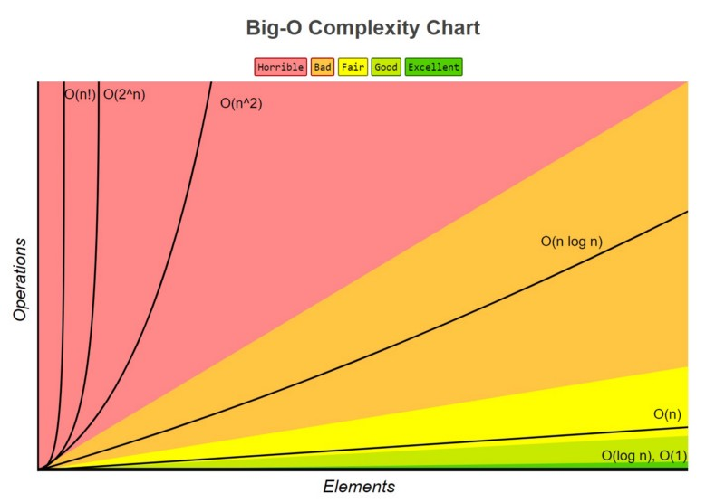

<
<
<
<
<
<

Slide 23
Example
Calculate the big-O notation for
f(n) = n [(n+1)/2]
Solution:
½ n² + ½ n (Remove the coefficient)
n² + n (keep the largest term)
n²
So, the big-O notation is stated as O( f(n) ) = O(n²)

